Slide 1

StereoSeq Bioinformatics downstream analysis examples
STOmics Americas
2024/02/15

Slide 2

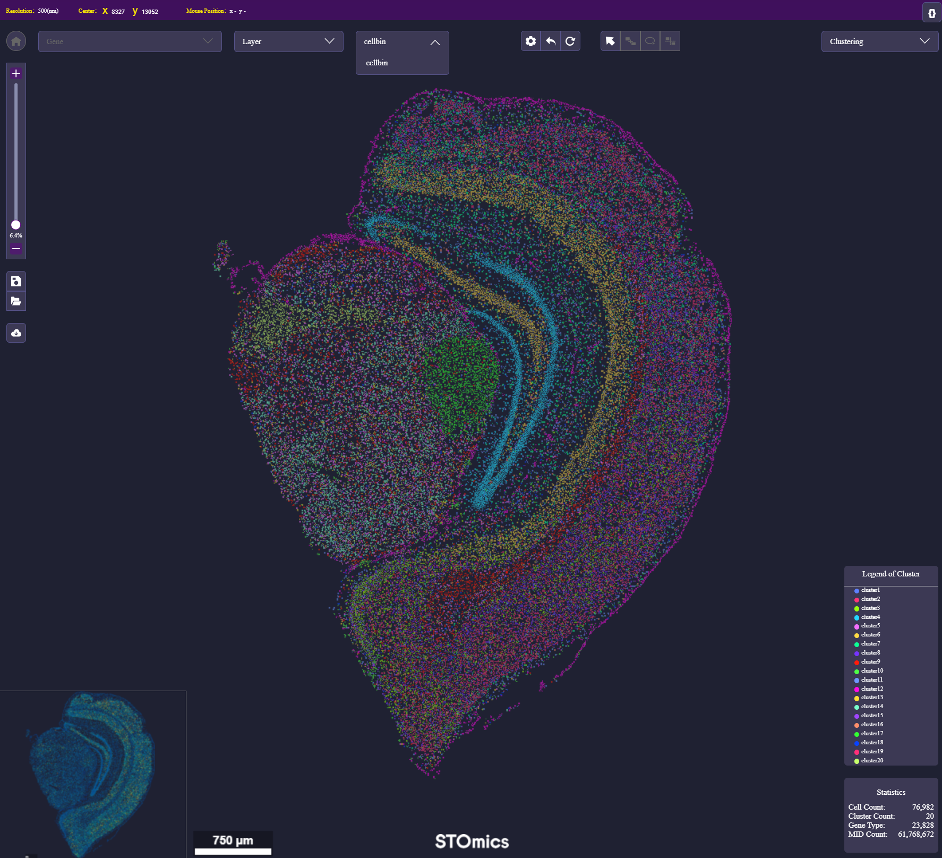
Clustering and cell type annotation
Clustering analysis
Unsupervised clustering
Supervised clustering
Marker genes for each cluster
Cell type annotation (based on marker genes for each cluster)
Automated cell type annotation (singleR)
Manual cell type annotation

Slide 3
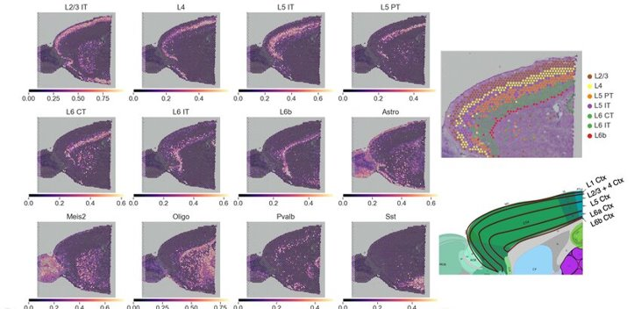
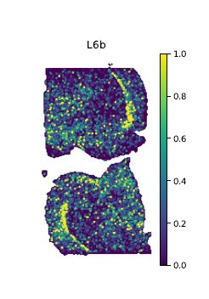
Enhanced cell type annotation by integrating scRNAseq data

Slide 4
Advanced cell segmentation analysis
StereoSeq Standard pipeline generates a default cell segmentation result
For most use cases, customized cell segmentation is needed

Slide 5
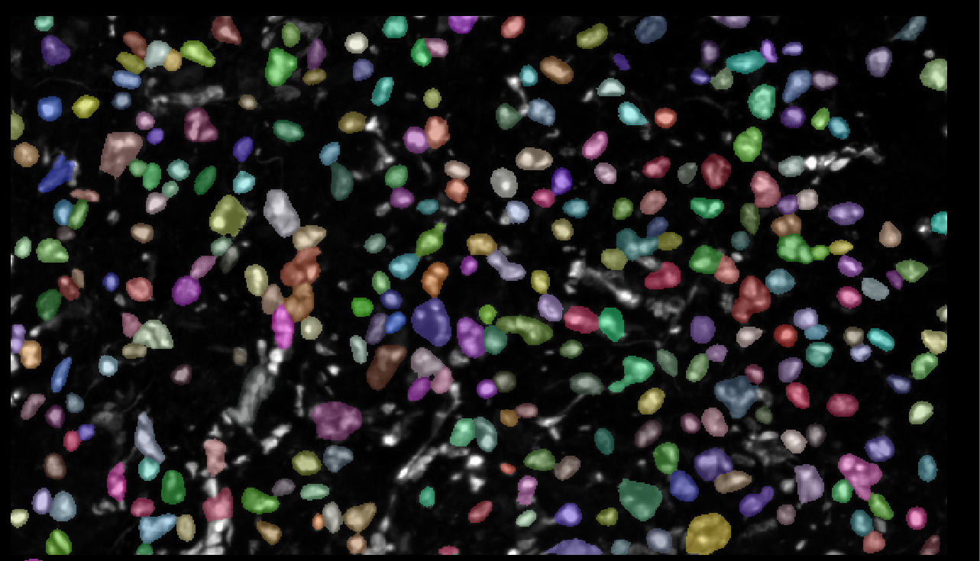
Cellpose with cyto model
ssDNA – original
segmented

Slide 6
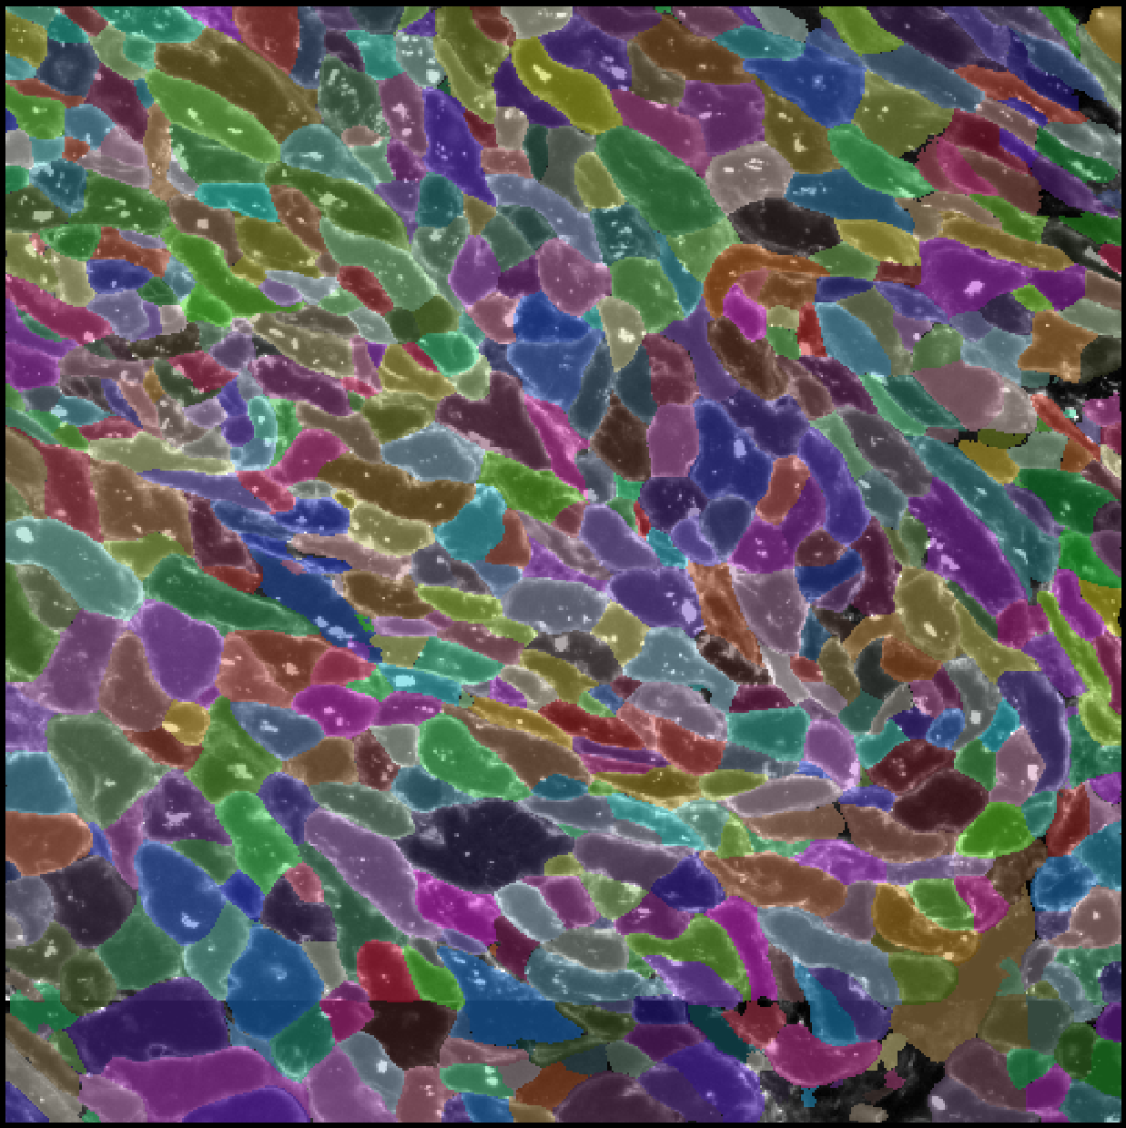
Cellpose with cyto2 model
original
Membrane stained
segmented

Slide 7
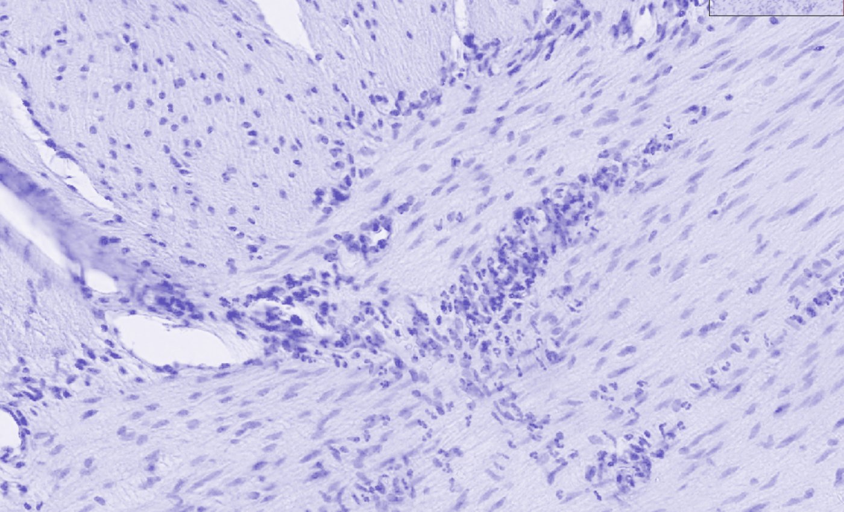
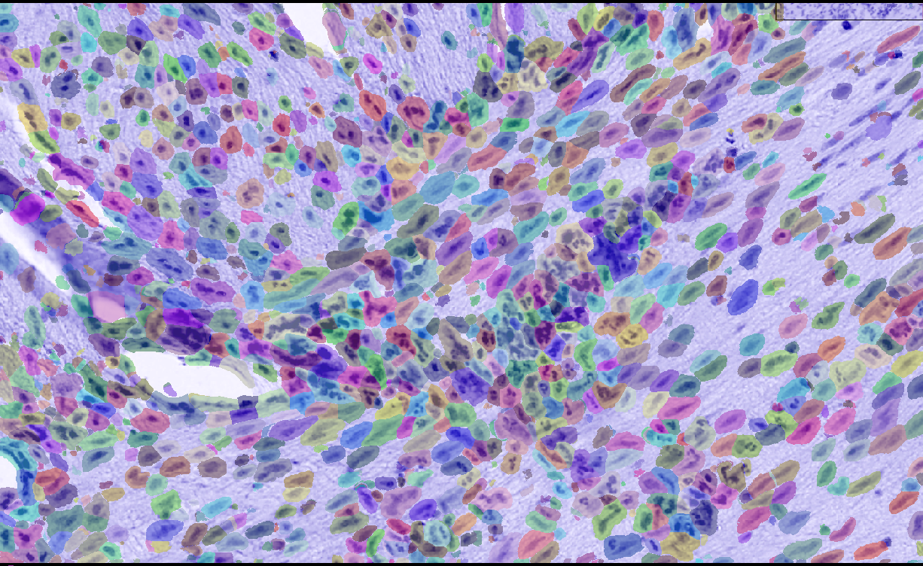
Cellpose with cyto model
H&E image – original
segmented

Slide 8
Other examples
Gene enrichment analysis
Advanced clustering analysis (subclustering, merging samples, etc.)
H&E image alignment (from adjacent slide)

